Slide 1
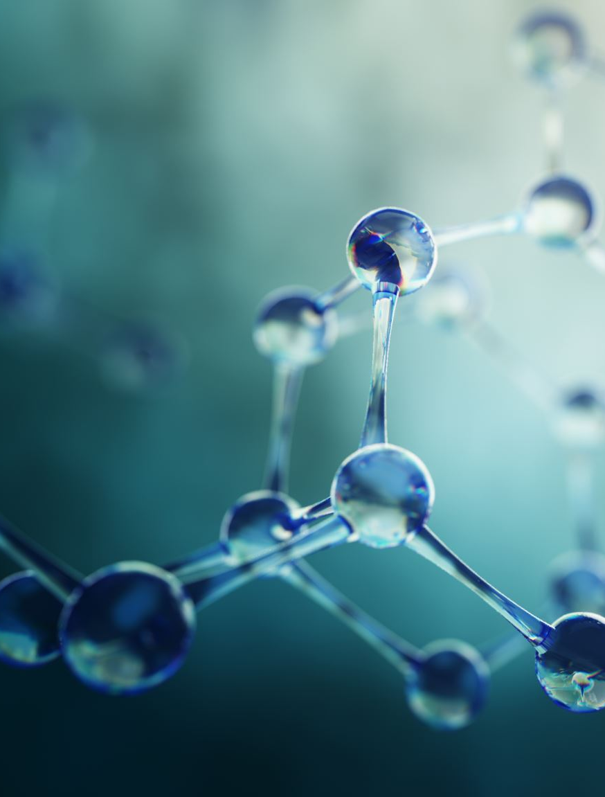
Doppler Physics
Chapter 19

Slide 2
Doppler
Named after Austrian Physicist Christian Doppler
The frequency of a sound wave for an observer is relative to its source
Known as the Doppler Effect or Shift
Simplified – The frequency of sound changes when the sound source and the receiver move either closer together or farther apart

Slide 3
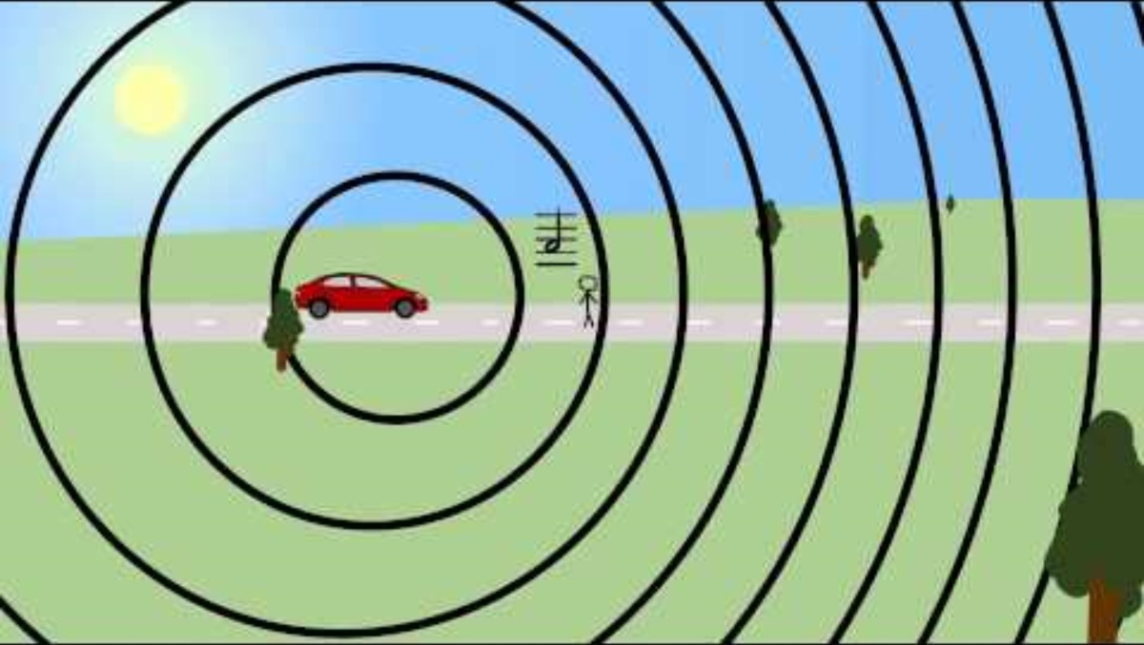
Doppler Effect

Slide 4
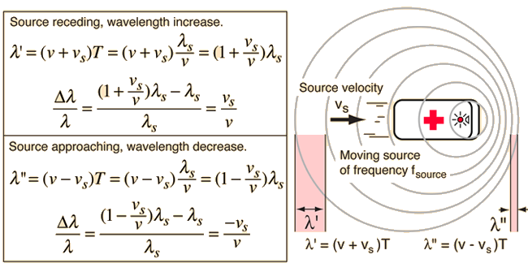
Doppler Equation

Slide 5
The Doppler Equation
2Vfo
Cos Θ
f
=
C
f = Doppler Shift
2 = Transmit / Receive Time
V = Blood Velocity
fo = Doppler Transmit Frequency
Θ = Cosine Theta
C = Propagation Speed

Slide 6
Use in Ultrasound
Doppler shifts are created when transmitted sound strikes red blood cells
When red blood cells move toward the transducer the Doppler shift is positive (the reflected frequency is higher than the transmitted frequency)
When red blood cells move away from the transducer the Doppler shift is negative (the reflected frequency is lower than the transmitted frequency)

Slide 7

Speed vs. Velocity
Speed is a magnitude
Velocity is a magnitude with direction
Doppler shift is directly related to velocity
Speed
Purely magnitude, indicates the distance that the red blood cell moves in 1 second.
Speed is reported in cm/second or any distance over time.
You would report your car speed as 45 miles per hour.
Velocity
Magnitude or speed and direction.
You are driving 45 miles per hour in your car to the east or to the west.

Slide 8
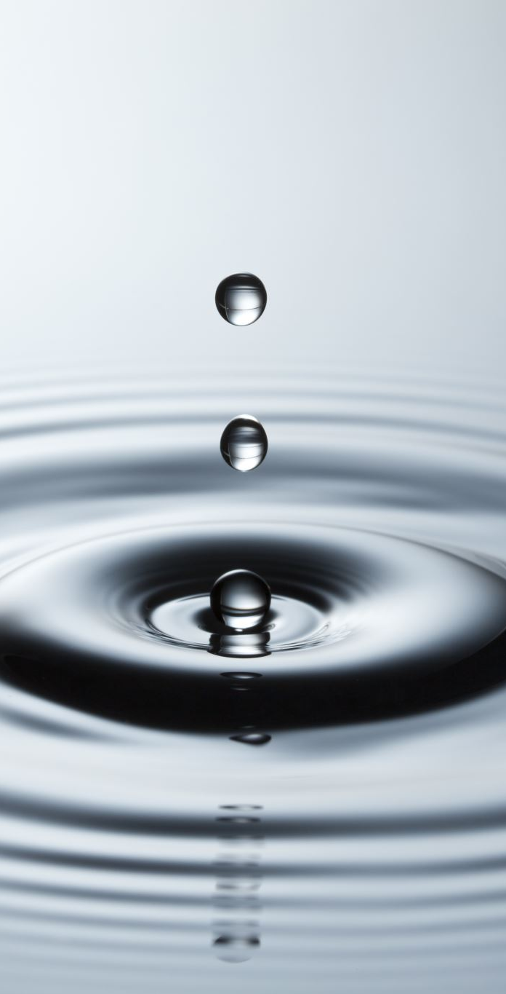
Doppler Shift
Depends on the velocity of blood cells
The faster the velocity, the greater the Doppler frequency
Doppler shift is measured in Hertz
The number 2 in the equation represents the two shifts that occur
1) The sound wave striking the blood cells
2) The reflected sound wave

Slide 9
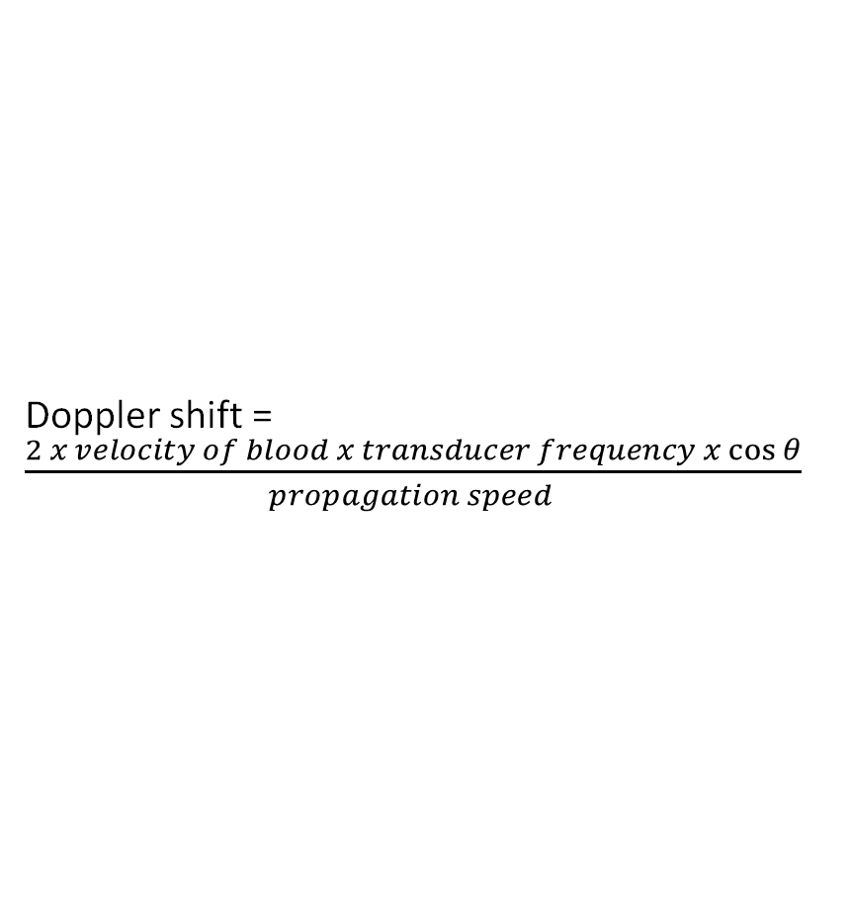
Doppler Equation Simplified
Doppler shift = $\frac{2 x velocity of blood x transducer frequency x\cos{θ}}{propagation speed }$

Slide 10
Doppler Shift Continued
Modern ultrasound systems convert the frequency shift in Hertz, to velocity in meters/sec
Doppler shift is directly related to the frequency of transmitted sound
Accurate shift measurement assumes the beams are parallel with flow
Correction for angle is done through using the cosine of the angle
Measured Velocity = True Velocity x Cos

Slide 11
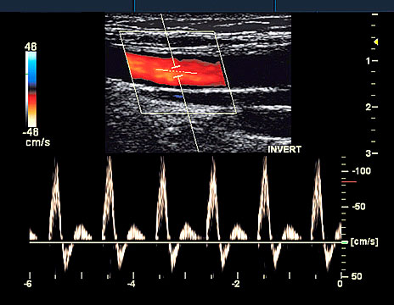
Anatomy of Doppler Wave
Scale
Converts kHz to m/s or cm/s…
X= time
Y= D shift
Baseline
Doppler signal
above the baseline
Doppler Signal below the baseline

Slide 12
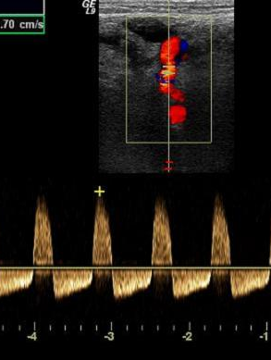
The Angle On Blood Flow
Doppler has constraints
Doppler equation states : frequencies received at zero degrees have the highest accuracy.
Optimum acoustic windows sometimes don’t permit using a zero angle.

Slide 13
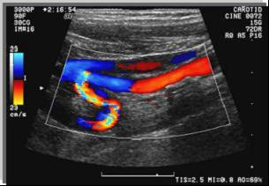
When an angle exists between the direction of flow and the sound beam, the measured velocity is LESS than the true blood velocity.
Measured velocity = true velocity x cos θ

Slide 14
Doppler and Angles
The Doppler equation also states :
Any angle between the Doppler beam and the blood vessel other than zero inaccurately portrays the returning signal.
Use angles within a specific range (zero to 60 degrees: always 0 degrees for cardiac.)
Cardiac Doppler
0-Degrees only
60- Degrees
0-Degrees
Abdominal and Vascular Doppler

Slide 15
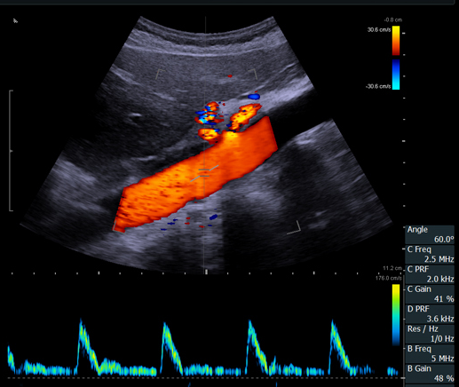
angle between blood flow and sound beam must be < 60 degrees

Slide 16
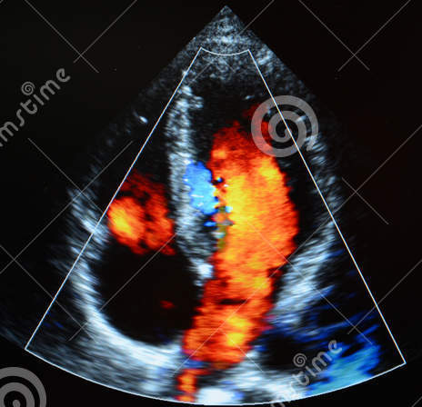
Flow angle either 0 degrees
Or 180 degrees

Slide 17
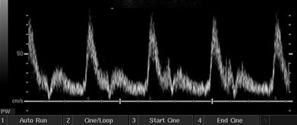
Spectral Waveform Defined
Peak Systole:
commonly used in determining the degree of stenosis
the point at which the cardiac cycle reaches its peak velocity
End Diastole:
end point of the cardiac cycle just prior to the systolic upstroke
used in diagnostic criteria
Spectral Window:
area inside the spectral tracing in systole
should remain clear in laminar flow and fill in with turbulent flow

Slide 18
Doppler Types
Pulsed Wave Doppler ( PW )
High Pulsed Wave Doppler ( HPRF )
Continuous Wave Doppler ( CW )
PW
HPRF
CW

Slide 19
Continuous Wave Doppler
Requires two crystals, one is always transmitting and other is always receiving
Advantages to CW is the ability to measure very high velocities
Disadvantages:
1) Range Ambiguity – Unable to determine exactly where the signal is coming from.
2) Lack of time gain compensation

Slide 20
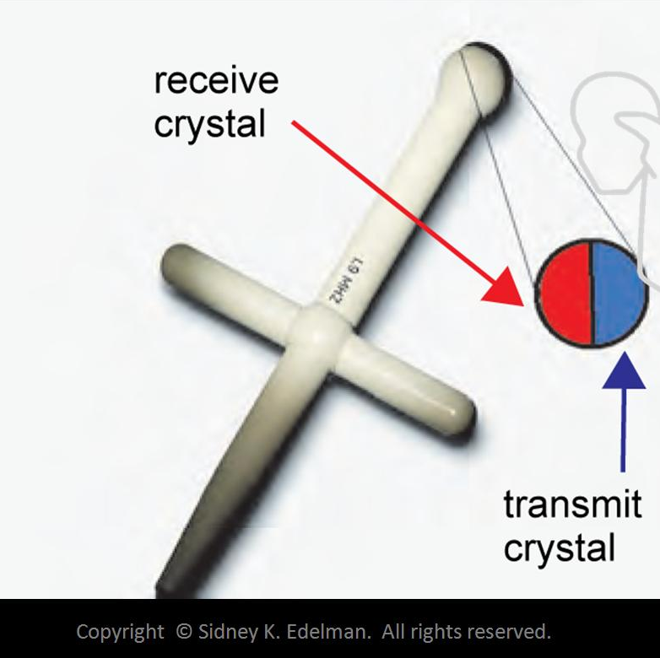
Continuous Wave Doppler
Requires two crystals
Does not create anatomical images
No discrete sample volume.
Restricted to the low PRFs employed in pulsed Doppler (no Aliasing).
CW Doppler is used to detect very high flow velocities.
No damping material:
narrow bandwidth
high Q
higher sensitivity and detection of small Doppler shifts

Slide 21
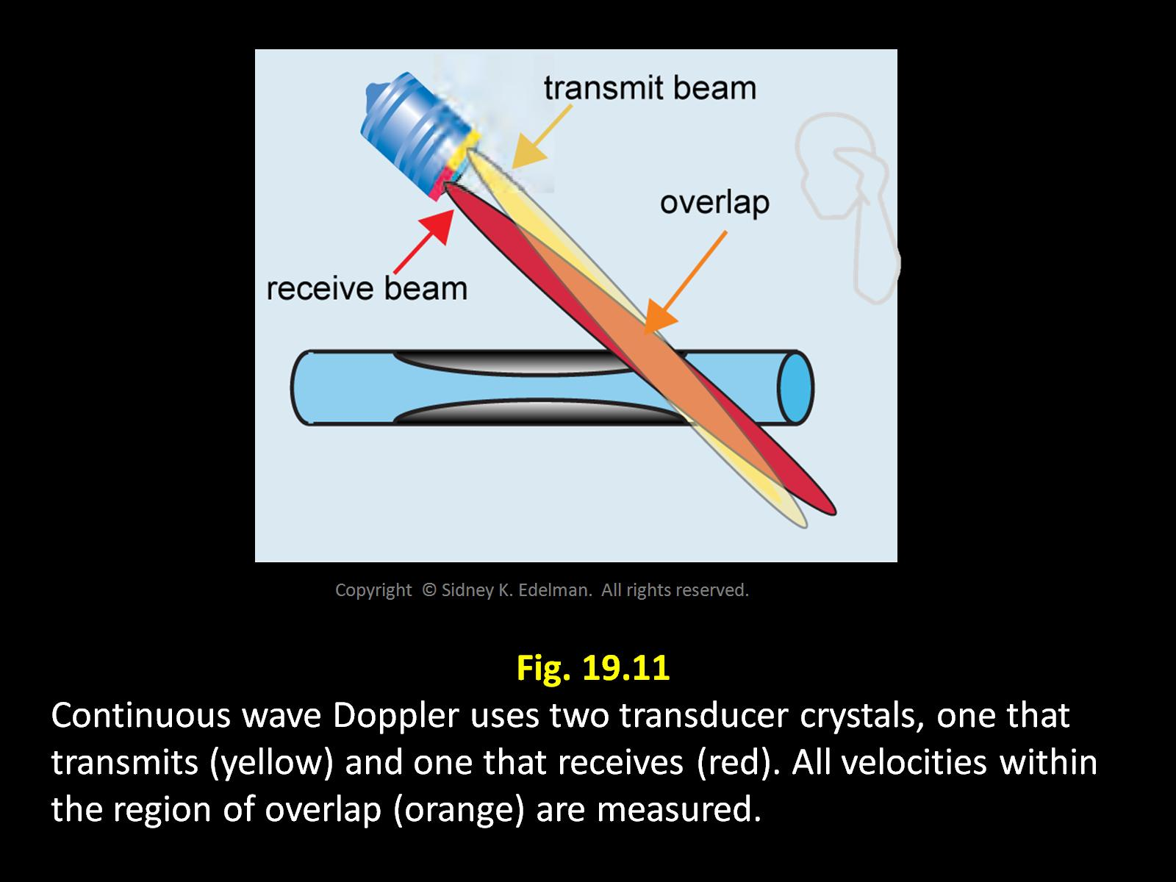

Slide 22
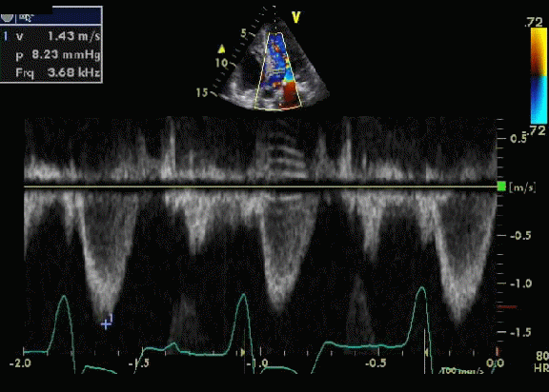
C W Doppler Caution
The sample volume in a CW beam is where the beams intersect. This area can be quite large depending on probe type and frequency. RANGE AMBIGUITY
Use caution not to sample multiple vessels at the same time.

Slide 23
Pulsed Wave Doppler
Uses one crystal that that alternates between sending and receiving ultrasound pulses
Reports peak velocities
Advantage is the ability to determine exactly where a shift came from this is called range gating, range resolution, or freedom from range ambiguity.
Disadvantage the inability to accurately measure high velocities. (Aliasing)

Slide 24
Pulsed Wave Doppler
Duplex
Simultaneously perfoms imaging and pulsed Doppler
Low Q factor
Lower sensitivity
Wide BW pulses

Slide 25
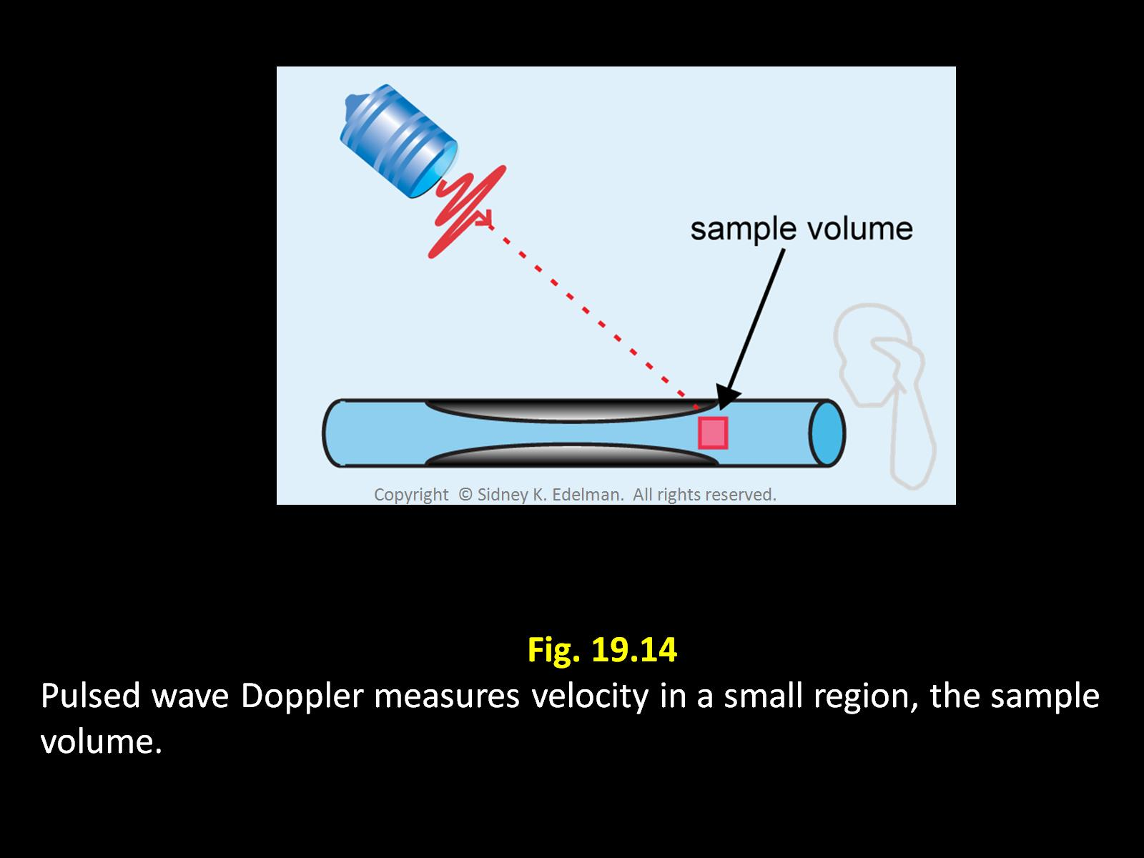
Pulsed Wave Doppler Advantages
The frequency is pulsed (PRF) thousands of times per second.
PRF determines the speed of the blood that may be detected unambiguously.
Can adjust receive gate, sample volume, gate
Sample volume

Slide 26
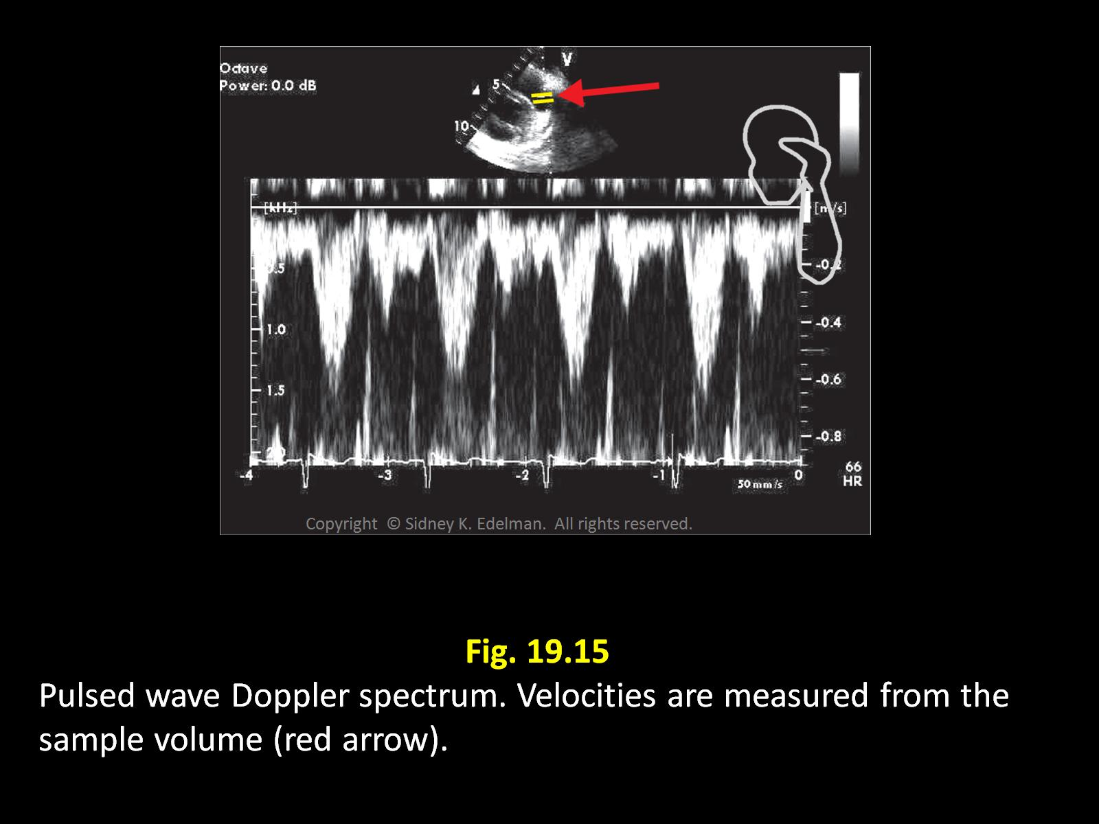

Slide 27
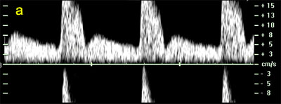
Pulsed Doppler Disadvantage
If the speed of the blood is faster than 1/2 of the PRF an artifact is generated called aliasing.
Aliasing displays the spectral waveform as “wrapping” around the spectral baseline.
An aliased waveform must be unwrapped for accurate spectral analysis.

Slide 28
Aliasing
Occurs only with pulsed wave Doppler
Occurs when the Doppler sampling rate is too low in comparison to measured blood velocity
When this happens, the cells moving at the higher velocity are displayed as moving in the opposite direction
Occurs more frequently at deeper imaging depths because it lowers the PRF

Slide 29
Nyquist Limit
The speed limit that determines where aliasing will start to occur
It is the highest Doppler frequency or velocity that can be measured without the appearance of aliasing
Nyquist Limit = PRF (Hz)/ 2
The higher the frequency the greater the aliasing

Slide 30
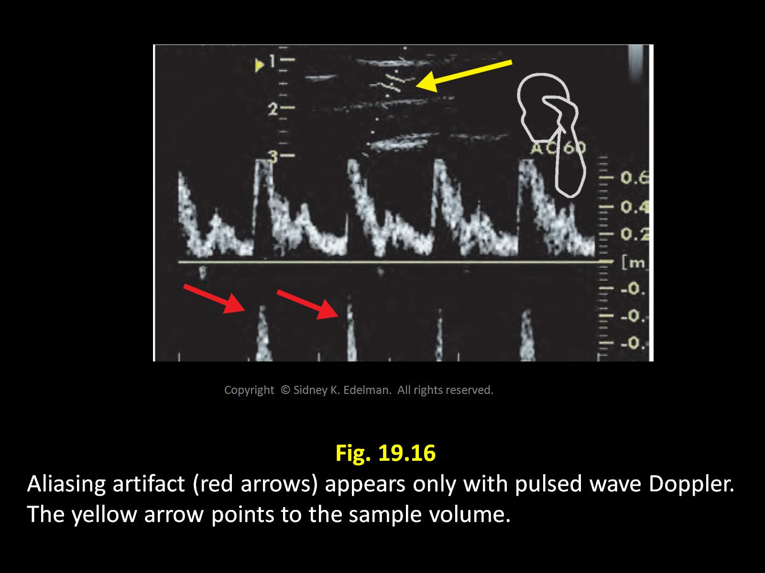

Slide 31
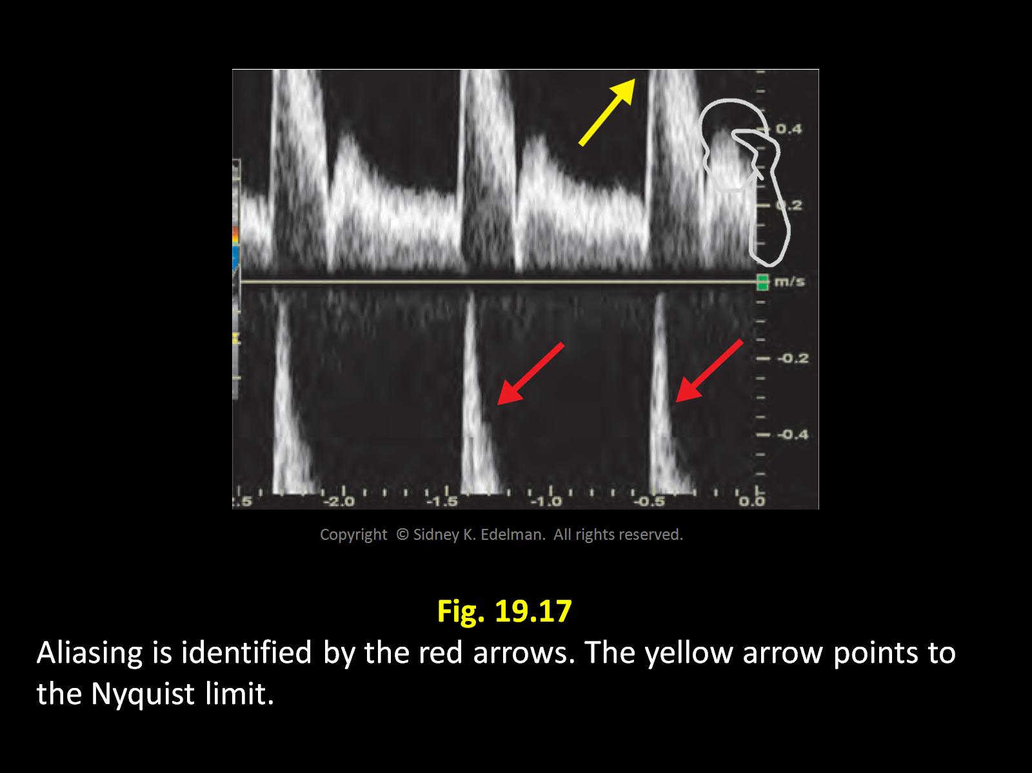

Slide 32
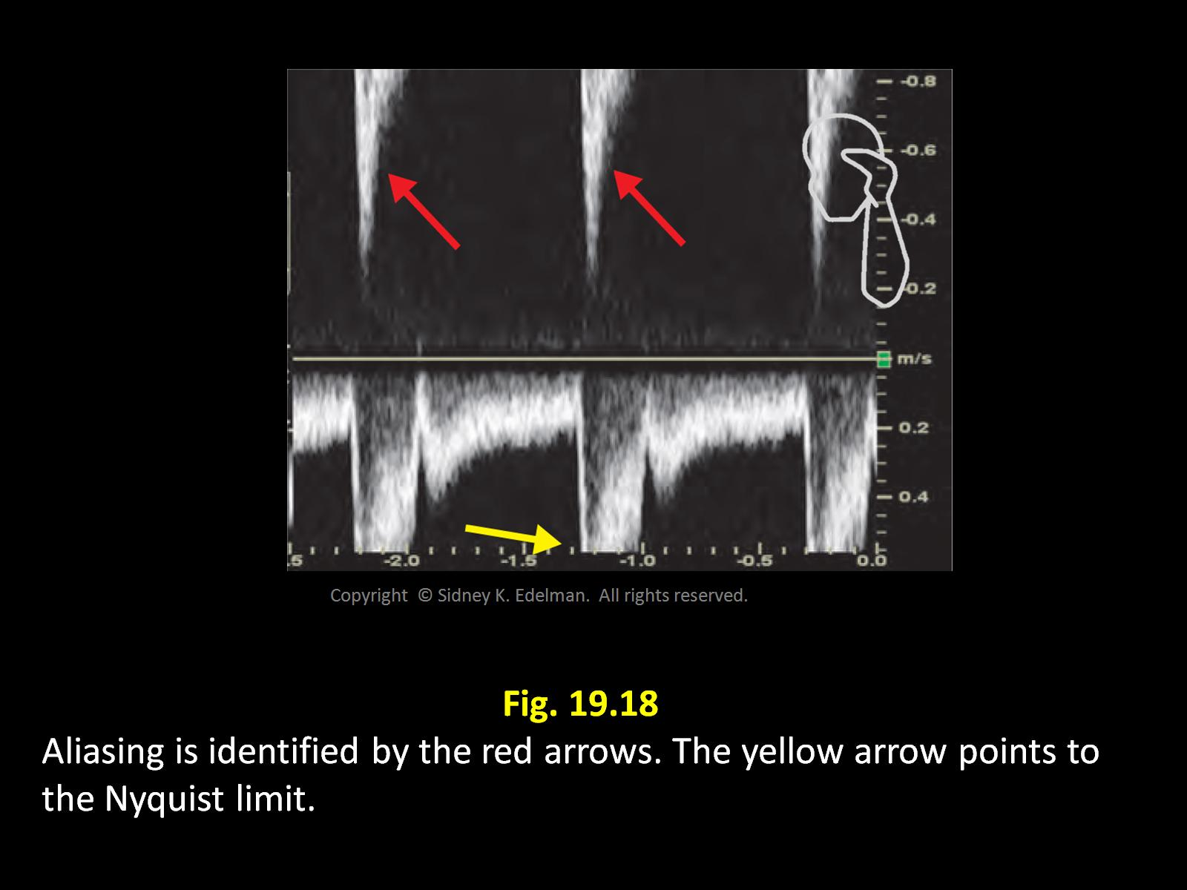

Slide 33
ALIASING
Never occurs with continuous wave
Occurs when Doppler sampling rate is too low in comparison to measured velocities.
Can you fix it?
Raise the Nyquist limit
Raise the speed limit
Reduce the Doppler shift
Reduce the speed

Slide 34
Aliasing
LESS ALIASING
slower velocity
lower F transducer (reduces Doppler shift)
shallow gate (high PRF)
MORE ALIASING
faster velocity
higher F transducer
deep gate (low PRF)

Slide 35
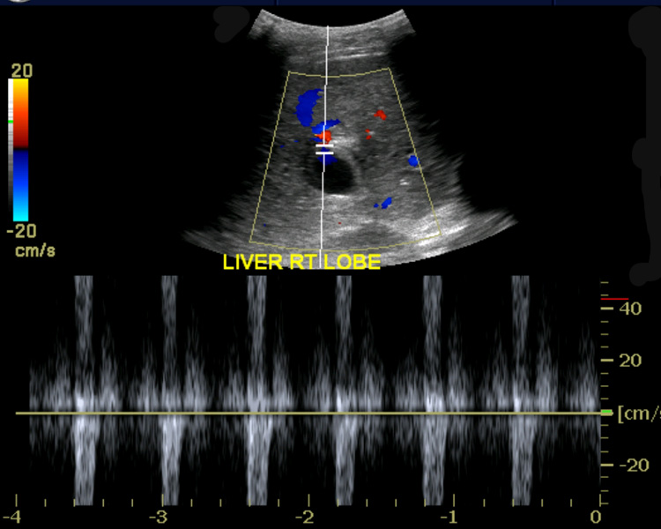
Avoiding Aliasing
Adjust the scale
This increases the PRF
Select a transducer with a lower frequency
Select a new view with a shallow sample volume
Use continuous wave Doppler (does not have aliasing)
Shift the baseline
This improves the appearance of aliasing but does not eliminate it- Purely a cosmetic fix

Slide 36
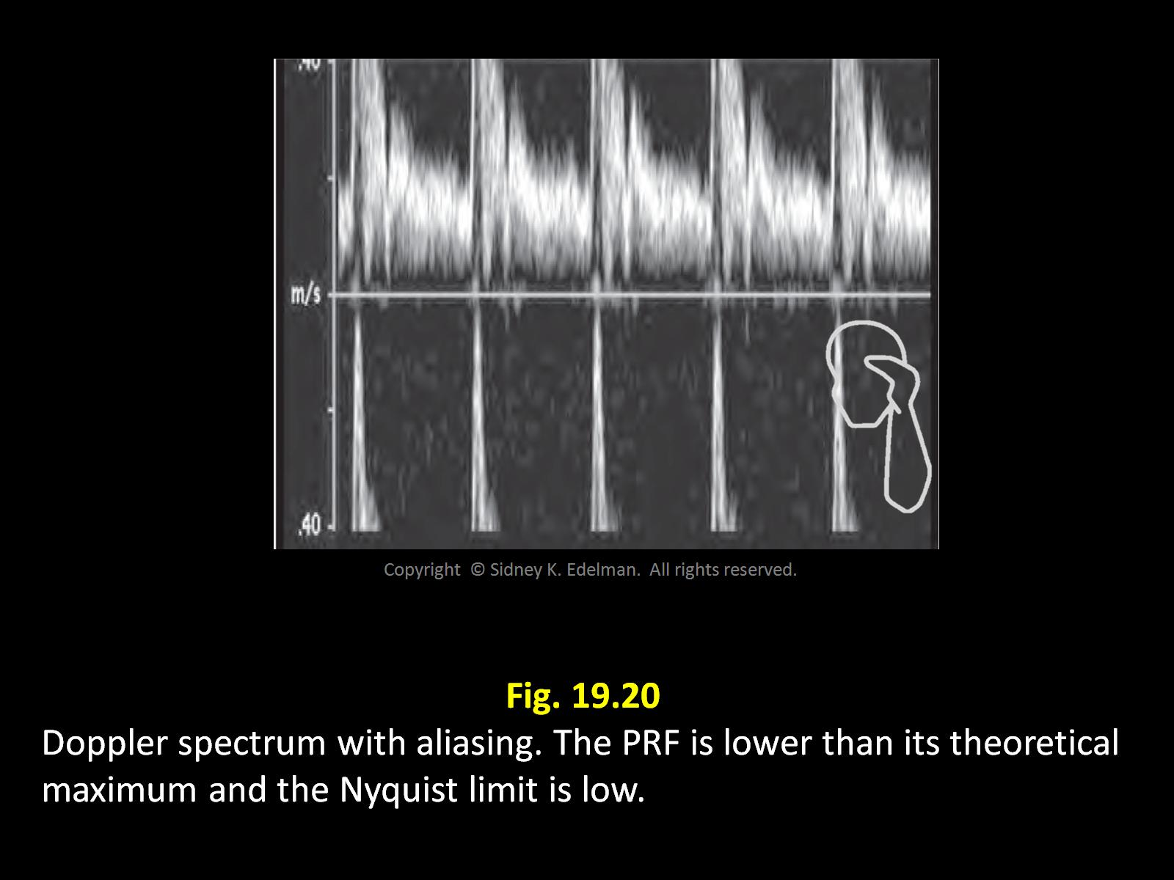
Adjusting the Scale

Slide 37
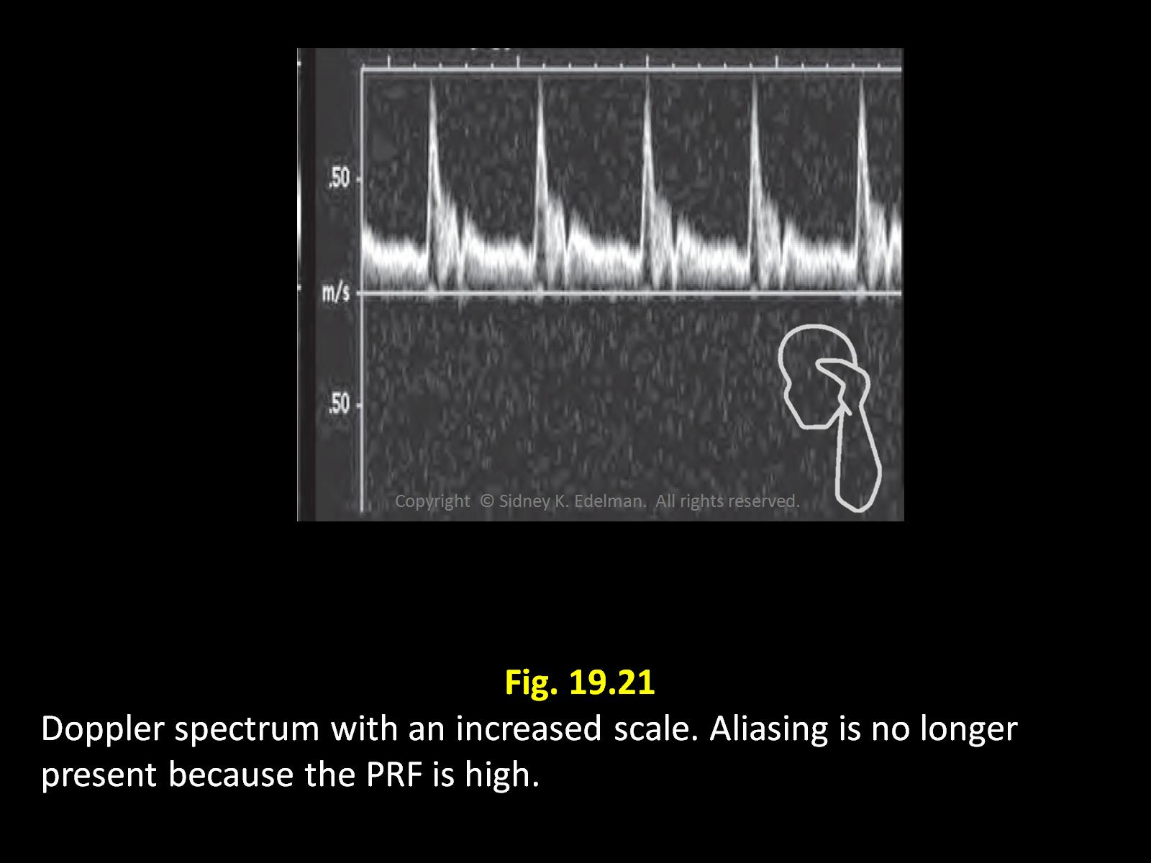
Adjusting the Scale

Slide 38
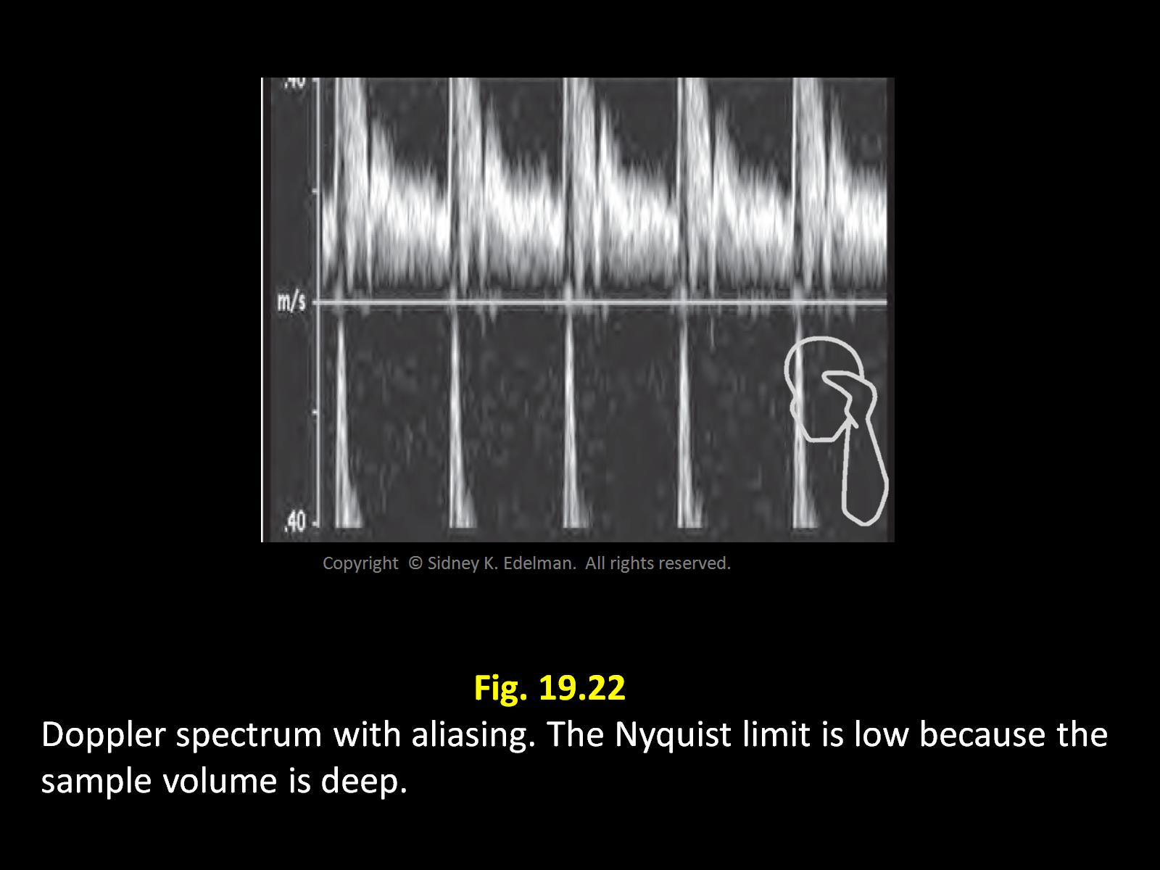
Adjusting the Sample volume

Slide 39
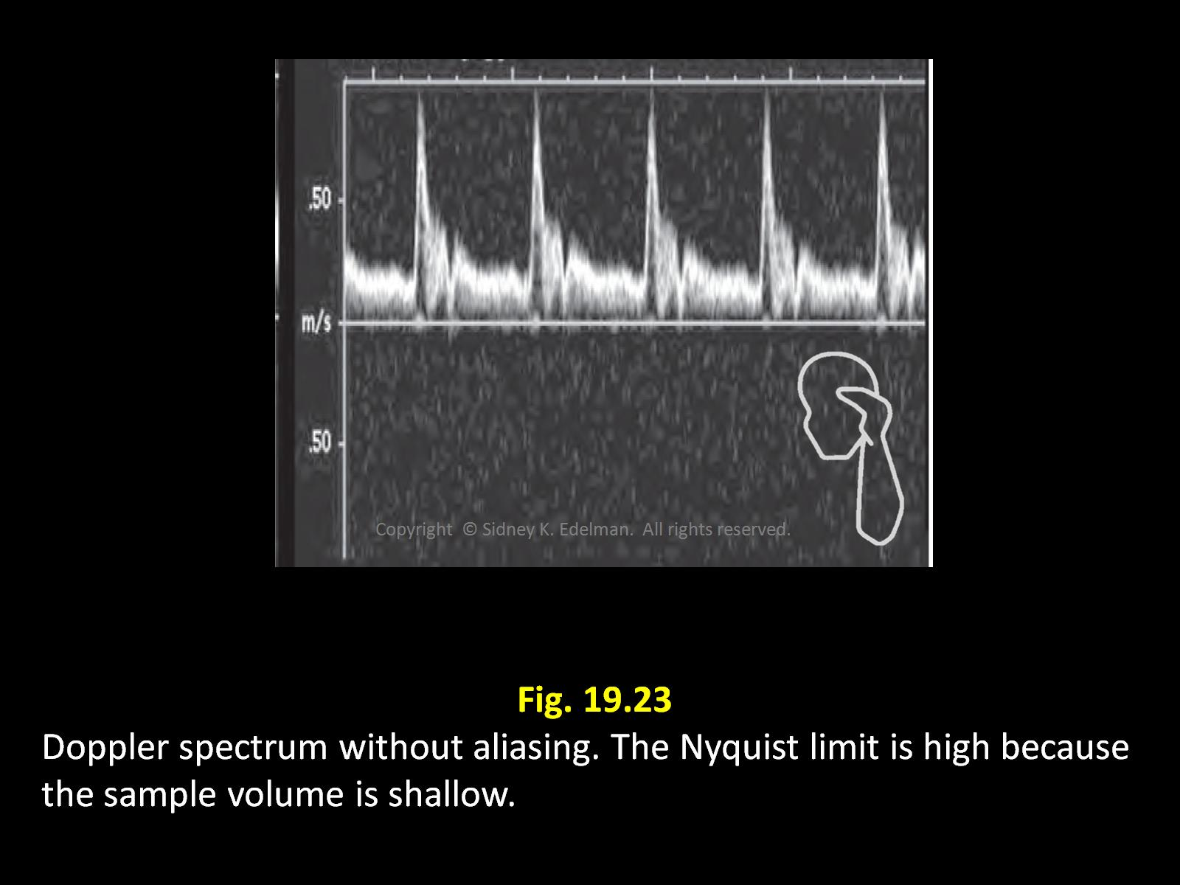
Adjusting the Sample volume

Slide 40
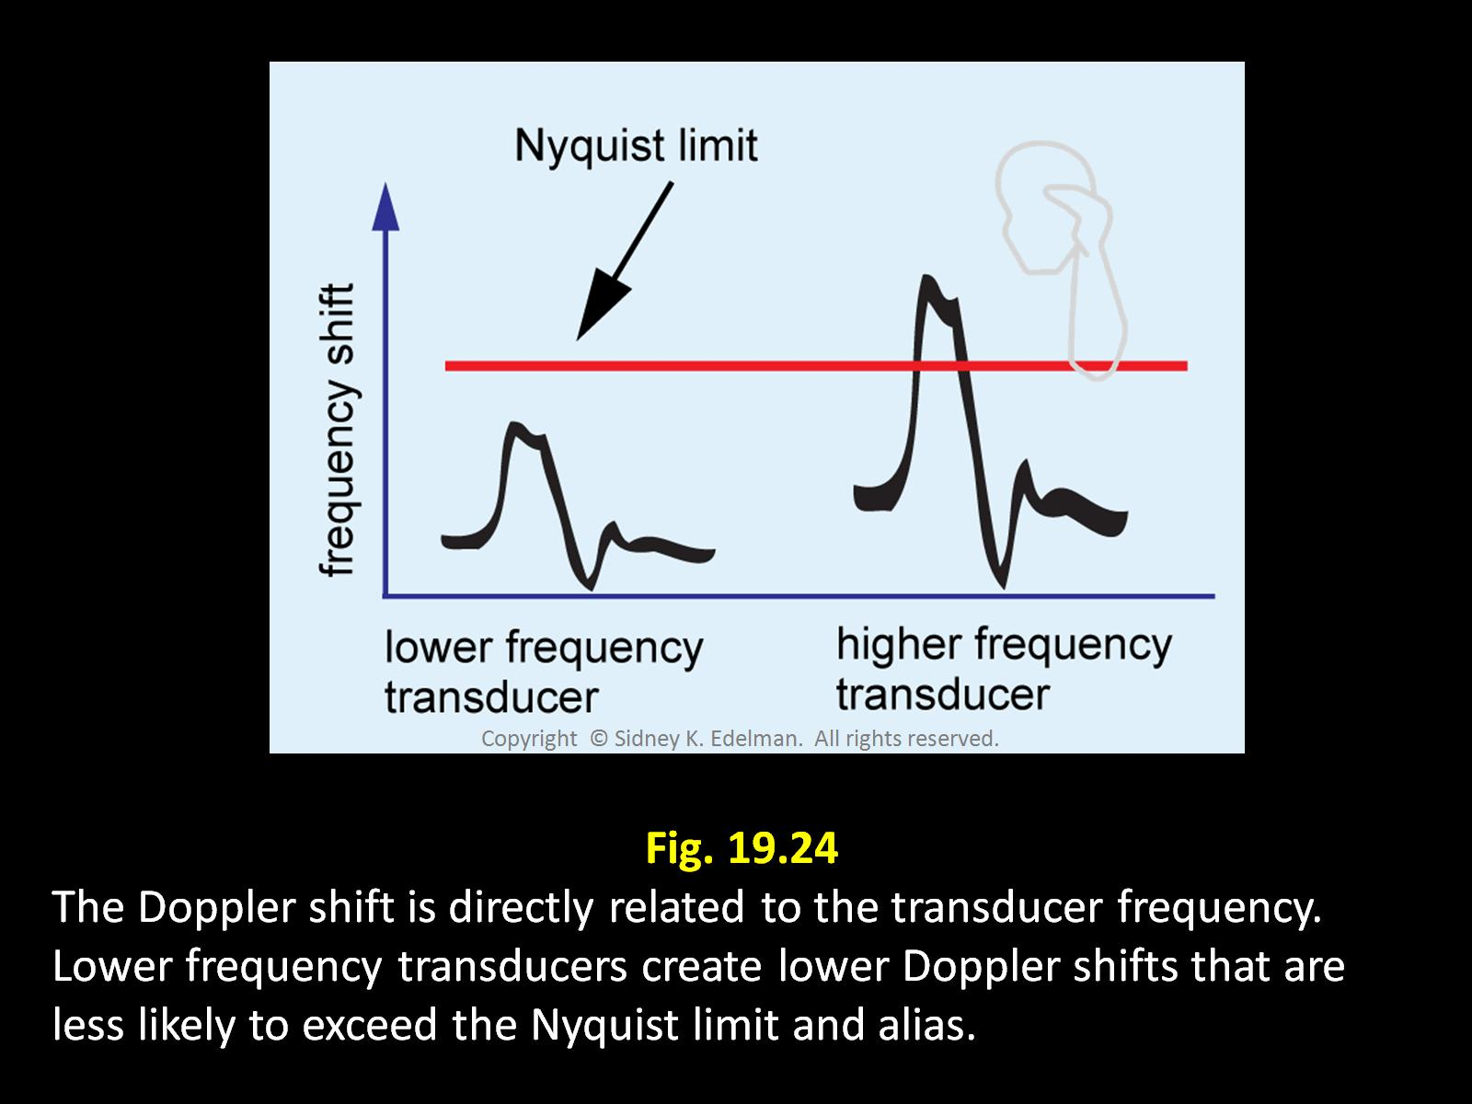
Adjusting the Frequency

Slide 41
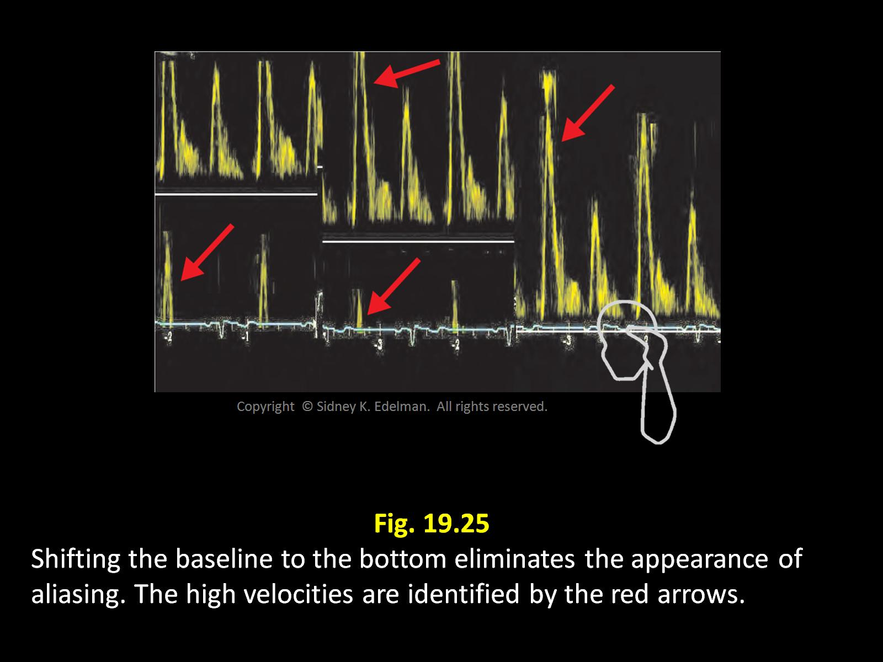
Adjusting the Baseline

Slide 42
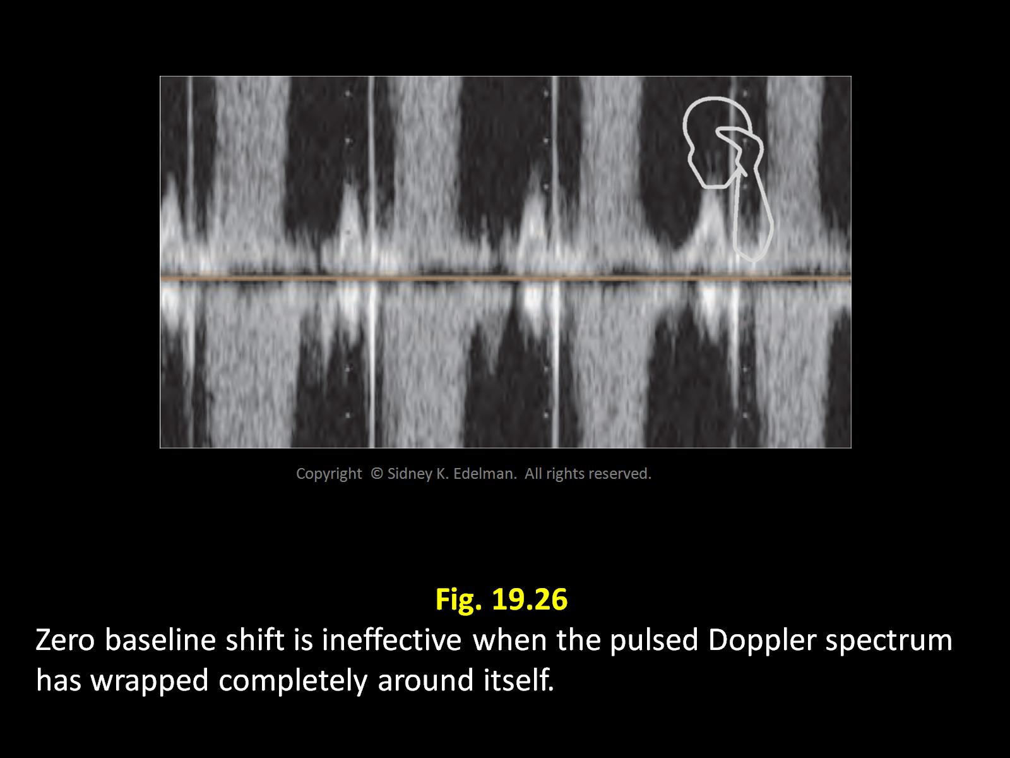
Adjusting the Baseline

Slide 43
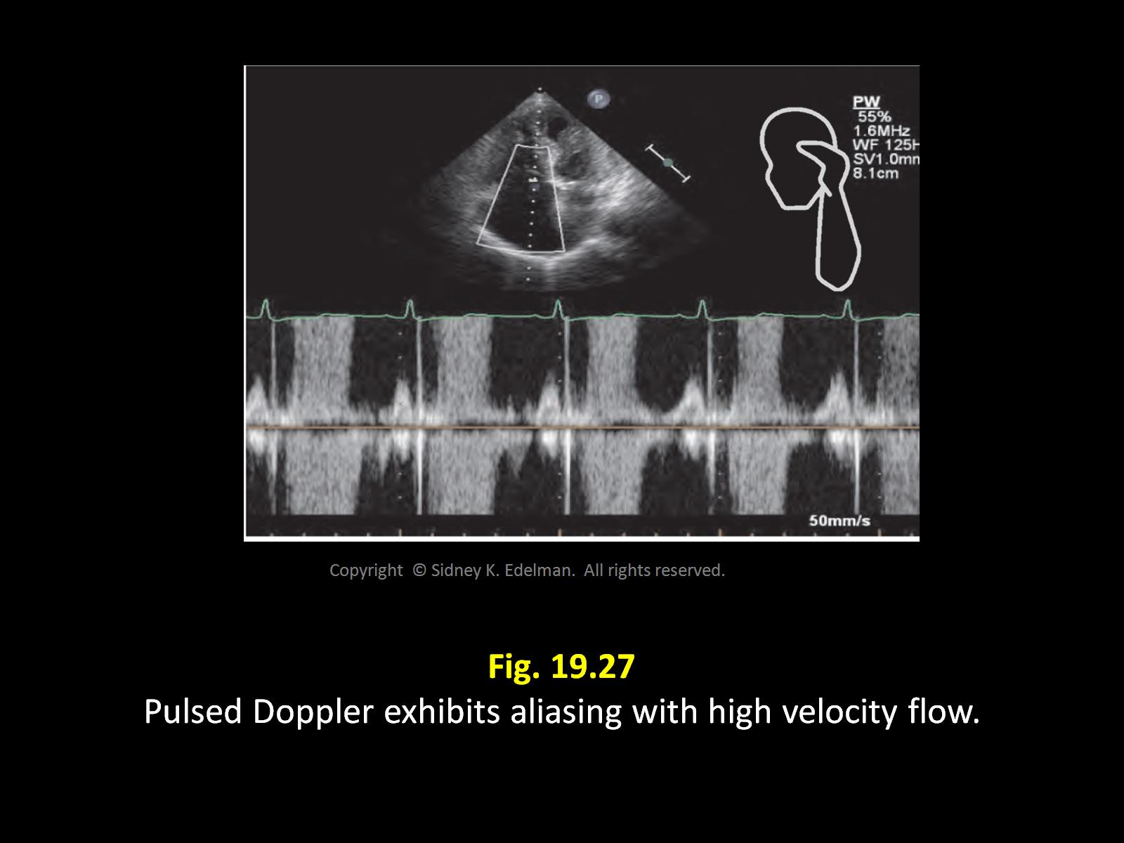
Adjusting the Baseline

Slide 44
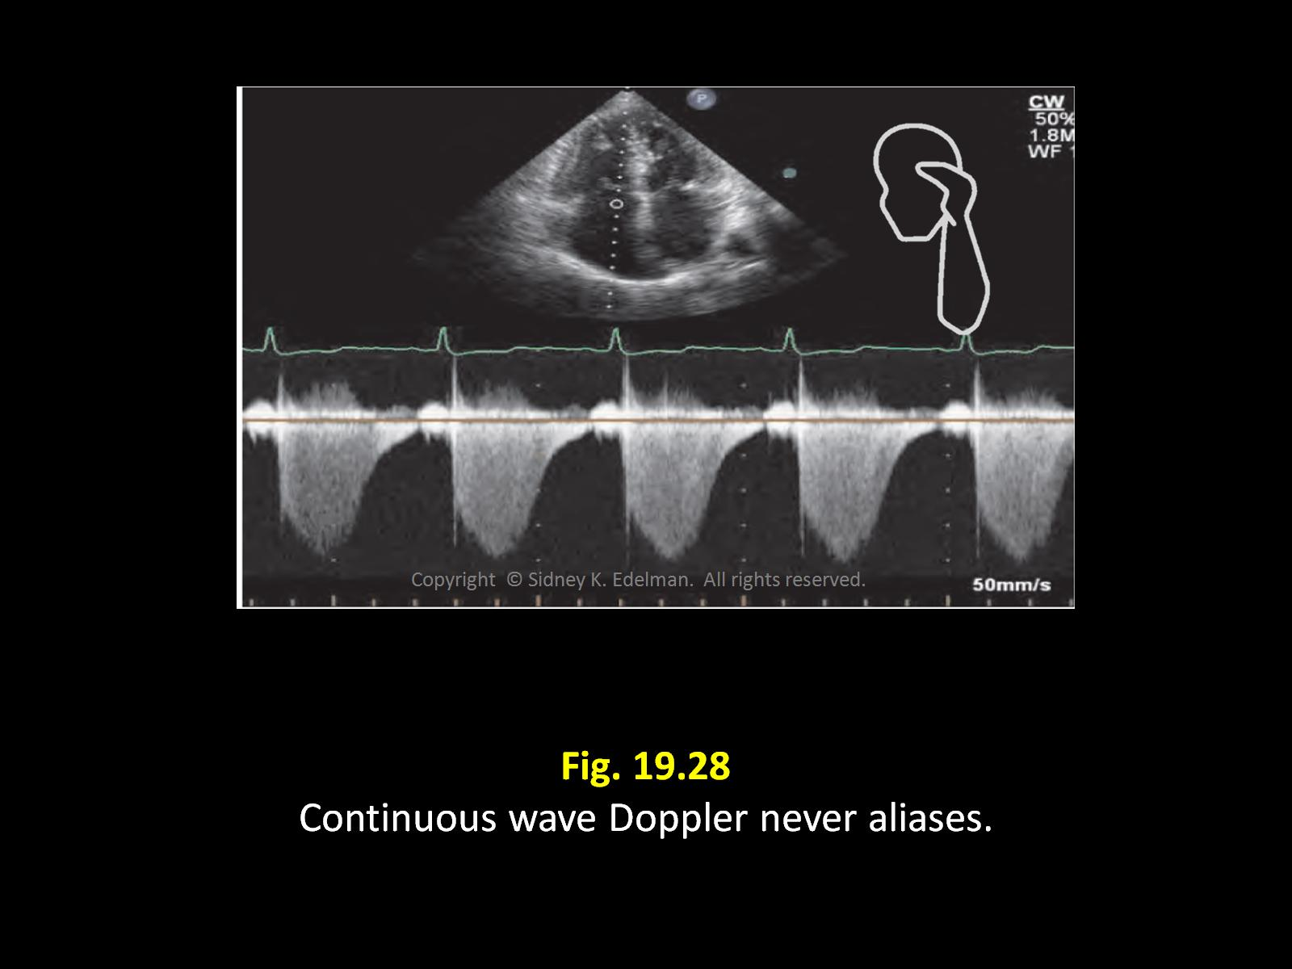

Slide 45
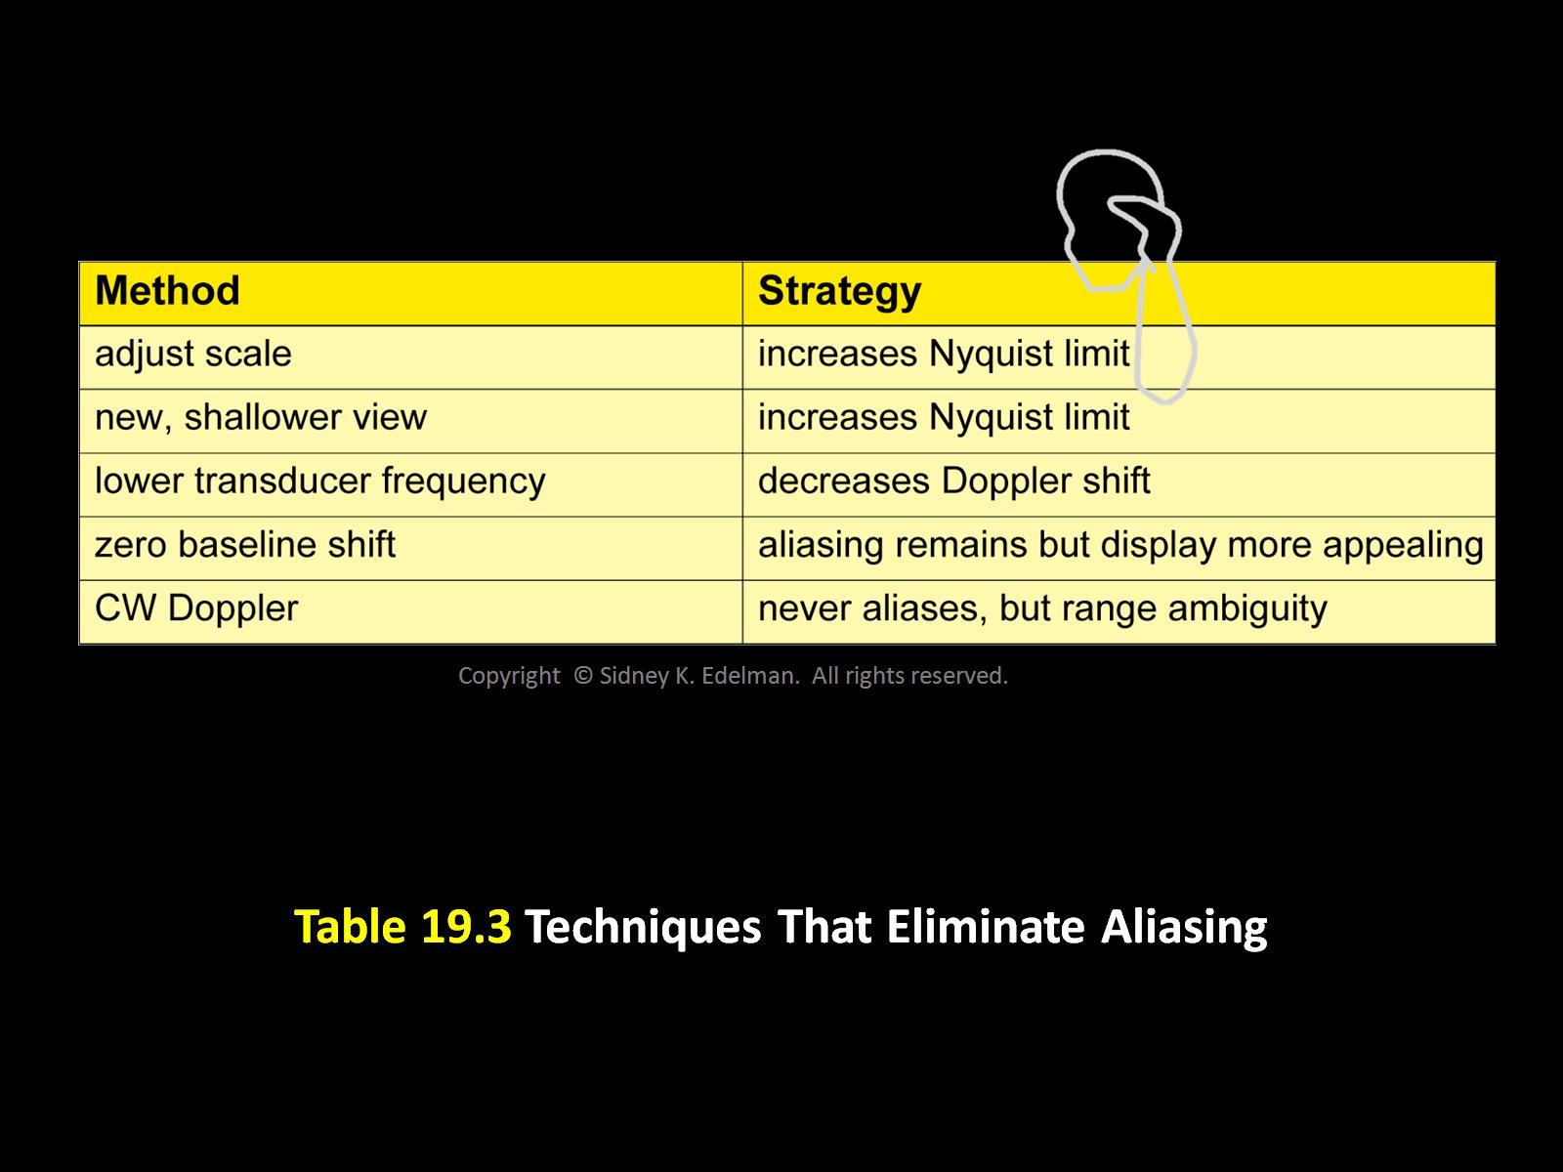

Slide 46
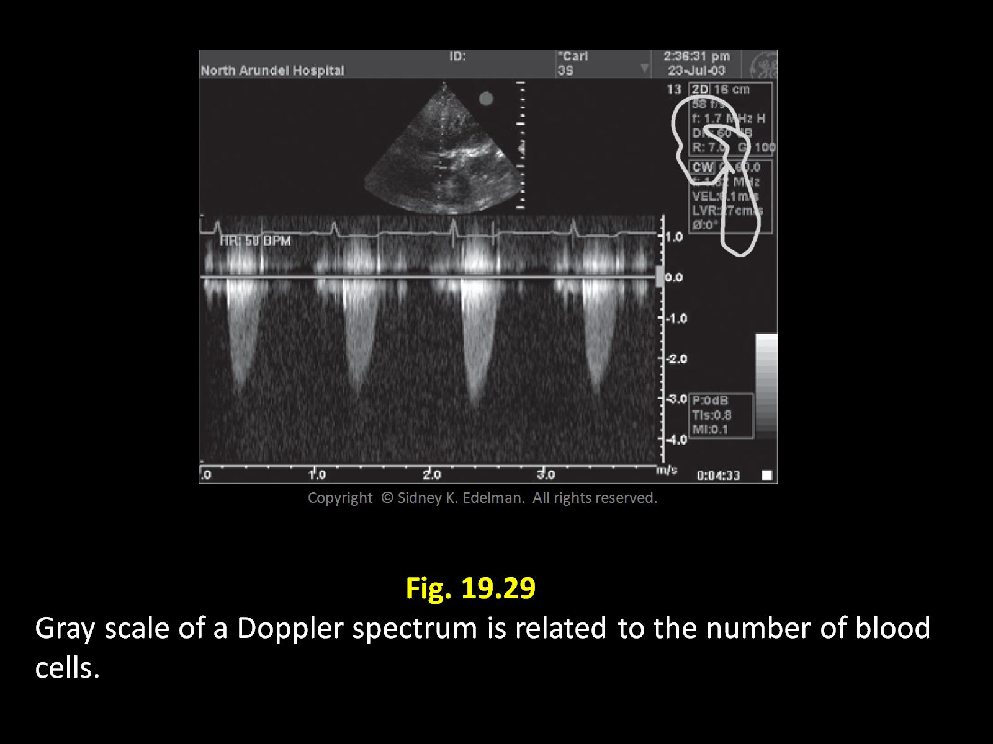
Gray Shade of a Spectrum
Amplitude OR number of RBC’s creating the reflection

Slide 47
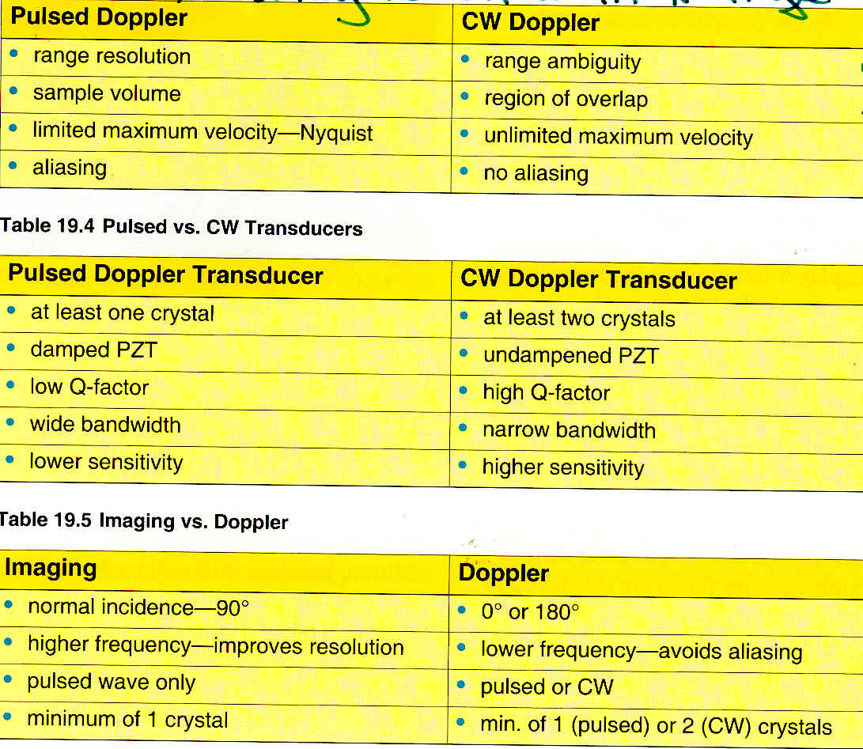

Slide 48
High PRF Doppler
HPRF Doppler employs multiple sample volumes placed at intervals along the Doppler cursor.
These sites can be sampled at a faster rate than PW Doppler and thus higher PRFs can be used.
Higher PRFs will detect and correctly display higher blood flows.

Slide 49
HPRF Caution
Provides multiple sample volumes at different points on the Doppler cursor.
All of these sample volumes are active, and caution must be used not to place more than one of them into different vasculature as multiple signals will be detected.
All detected signals will be written and superimposed in the Doppler display. (very confusing)

Slide 50
Doppler Technologies
Pulsed/HPRF Doppler proves accurate detection of blood flows at precise locations by using sample volumes.
Both technologies will alias due to PRF constraints.
CW provides accurate detection of high-speed flow velocities but has limited range location capabilities. Large sample volumes can cause confusion.
CW Doppler will not alias.

Slide 51
Color Flow Doppler
A form of two-dimensional Doppler
Static structures are assigned grays scale colors, while moving structures( red blood cells within a structure) are assigned colors
Color Doppler reports the average velocities (AKA mean velocities) while spectral doppler (CW and PW) report peak velocities

Slide 52
Color Doppler
Provides information on the location of flow
Details the direction of flow
Based on Pulsed wave technology
1) Has range specificity
2) Subject to aliasing

Slide 53
Color Maps
Color Doppler uses a dictionary (table) to convert velocities into colors that appear on the image
There are two commonly used tables
1) Velocity Mode – distinguishes flow toward and away from the source.
Does not see side to side motion.
2) Variance Mode – distinguishes laminar flow from turbulent flow.
Does detect side to side motion

Slide 54
What is the “Standard” Color Doppler Display VELOCITY MODE
Flow towards the probe is colored “RED”
Flow away from the probe is colored “BLUE”
An aliased signal will show the directional colors “wrapped” into each other
Turbulent flow will show a “mosaic” pattern of colors

Slide 55
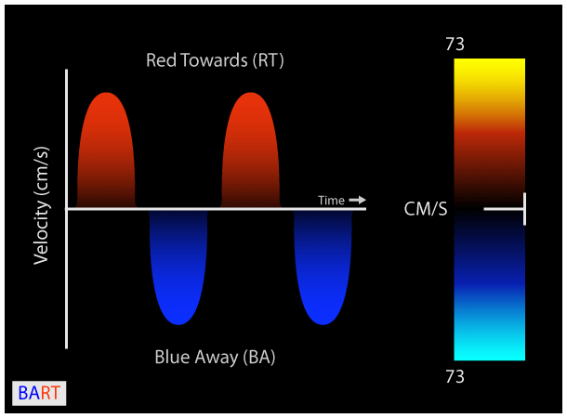
Color Bar Velocity Mode:
FLOW DIRECTION
Which is a positive Doppler shift?
Lighter shades =
higher velocities
Color baseline:
NO DOPPLER SHIFT
Lighter shades =
higher velocities

Slide 56
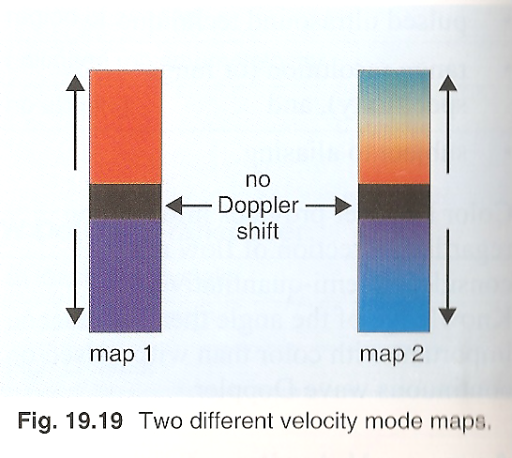

Slide 57
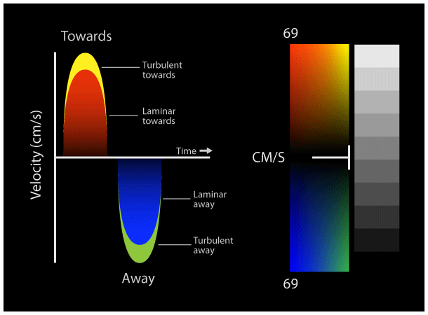
Color Bar Variance Mode:
Distinguishes LAMINAR FLOW from TURBULENT FLOW
Read left to right for flow
Left = laminar
Right = turbulence

Slide 58
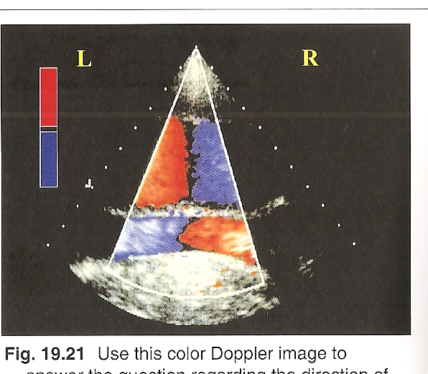
Direction of Flow Sector shape

Slide 59
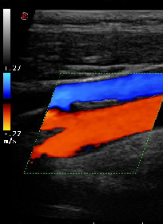
Direction of Flow Rectangular shape
Find “HOME”
Screen orientation as you are looking at it…not in ultrasound terminology
This is imaginary location of transducer

Slide 60
Look at velocity map
Blue is toward the Transducer
Move finger in vessel toward the transducer
Flow is left to right

Slide 61

Doppler Packets
Color Doppler, multiple ultrasound pulses are used to accurately determine blood cell velocities.
The multiple pulses are called a packet or ensemble.
If you have a larger number of pulses, then you have a larger packet.

Slide 62
Larger packets have 2 advantages:
More accurate velocity measurement
More sensitive to low flow
Larger packets have 3 disadvantages:
More time needed to acquire data
Reduced frame rate
Decreased temporal resolution
Packet size must be carefully selected to balance two competing interests of color Doppler: accurate velocity measurements and adequate temporal resolution

Slide 63
Power Doppler
Detects the presence of shift only
Does not evaluate speed or direction
Also knows as Color Angio
Processes the amplitude of the signal only
A form of non-directional Doppler

Slide 64
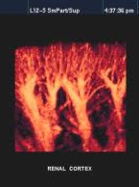
Power Doppler
All Doppler shifts are colorized without consideration for direction or speed
In a Power Doppler image, all of the vessels are the same color, regardless of direction of flow.

Slide 65
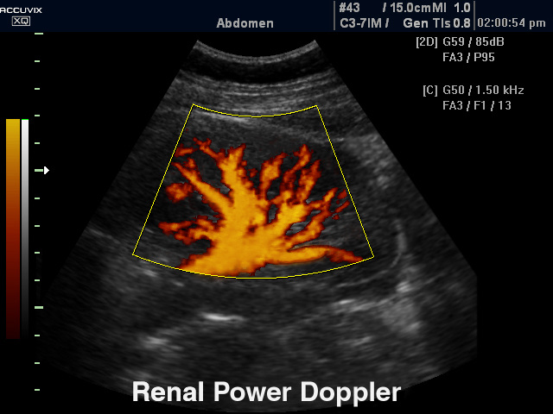

Slide 66
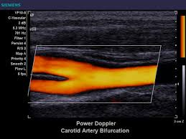
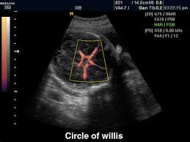

Slide 67
Power Doppler Usage
Advantages:
1) Increased sensitivity for low flow or low velocities
2) Unaffected by Doppler angles
3) No aliasing since velocity information is ignored
Disadvantages:
1) No measurement of velocity or direction
2) Lower frame rates or decreased temporal resolution
3) Susceptible to motion of transducer, patient or soft tissues

Slide 68
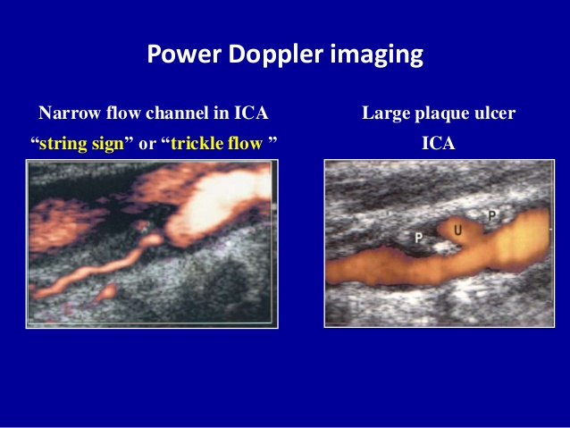

Slide 69
Doppler Artifacts
Ghosting and clutter – very low velocity shifts from moving anatomy. Eliminated by using a wall filter
Crosstalk – A form of mirror imaging artifact that only occurs with spectral Doppler.
Caused by either:
1) Doppler receiver gain set too high
2) Incident angle at or near 90 degrees
A wall filter is used to eliminate clutter or ghosting

Slide 70
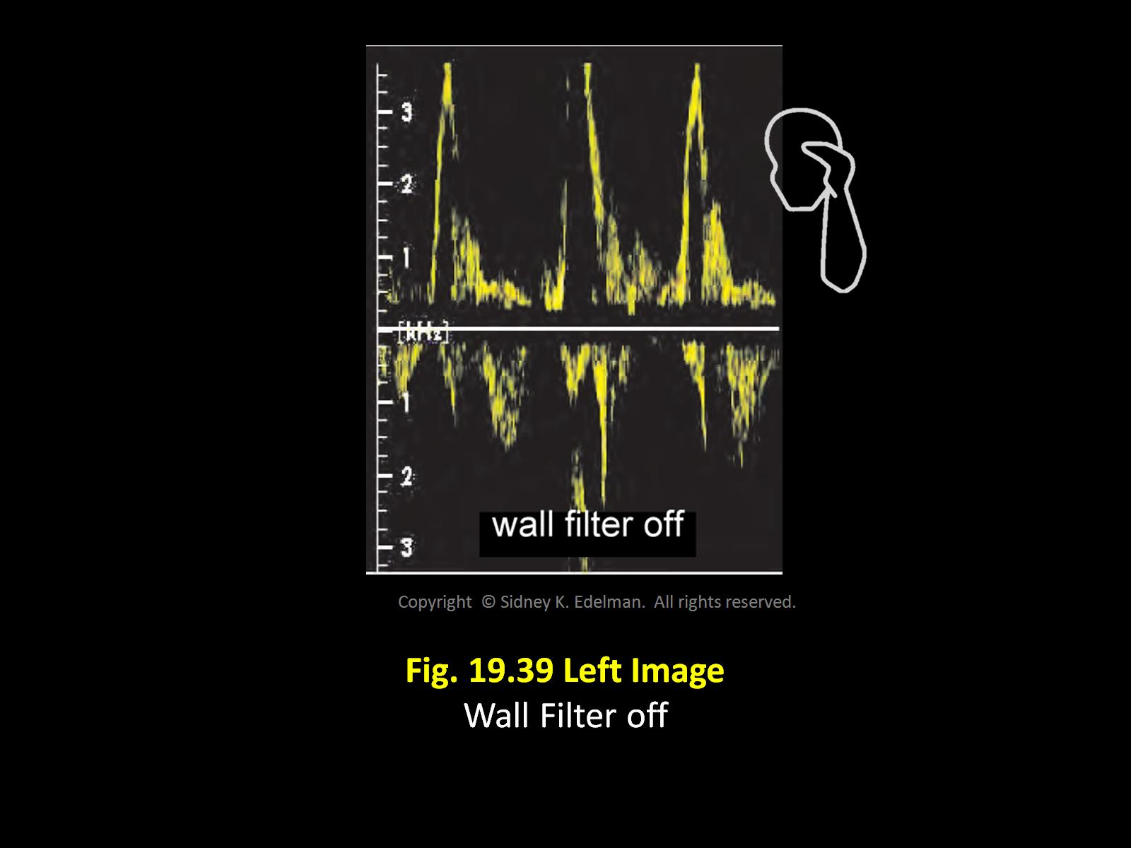
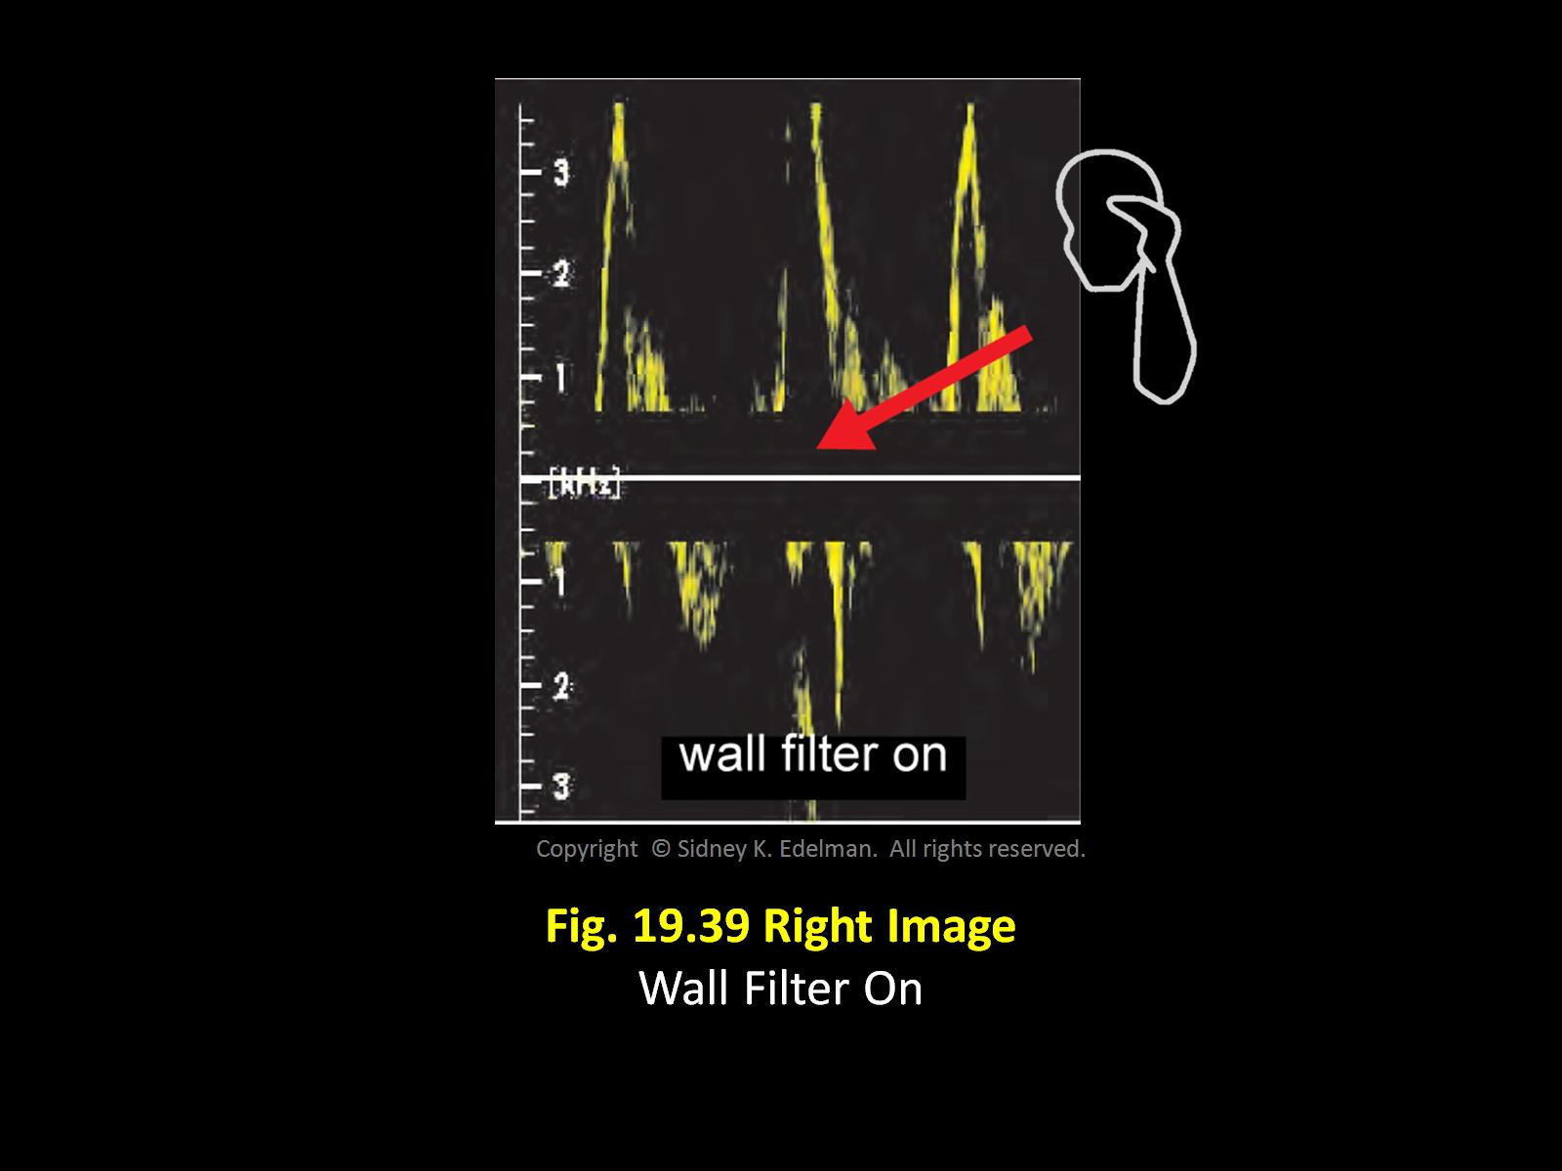
Doppler Artifacts:
Clutter

Slide 71
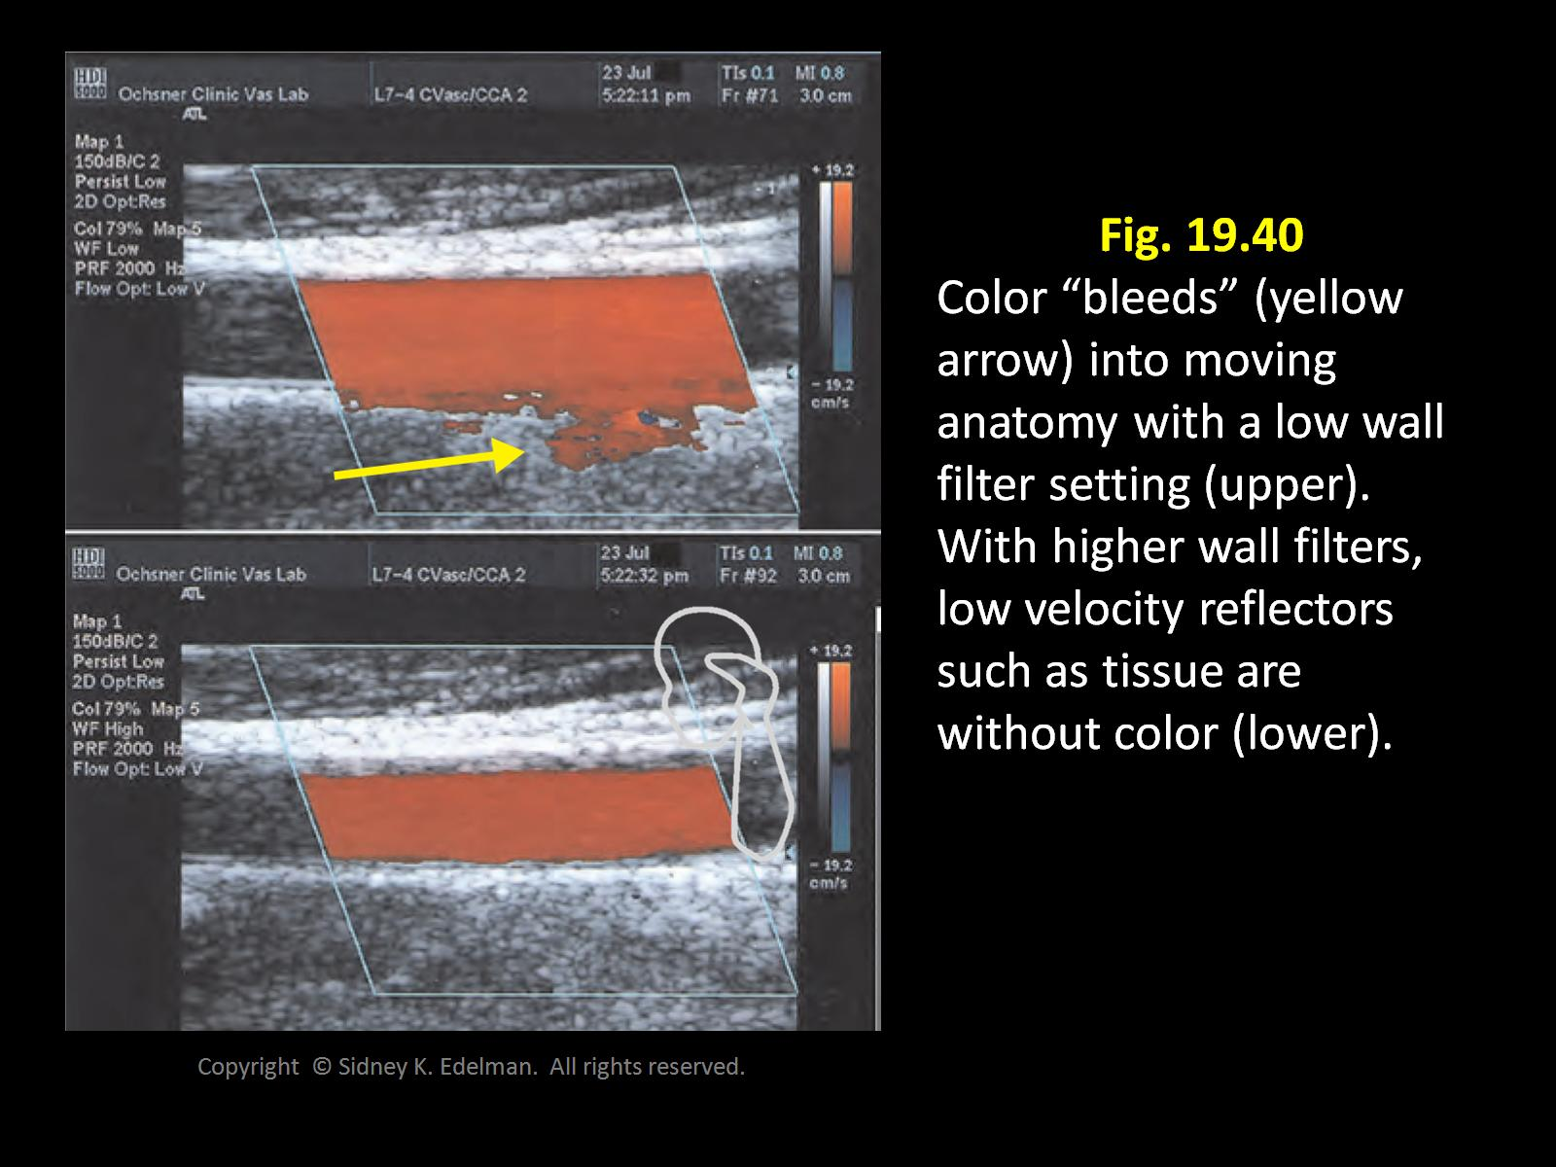
Color Doppler Artifacts:
Ghosting

Slide 72
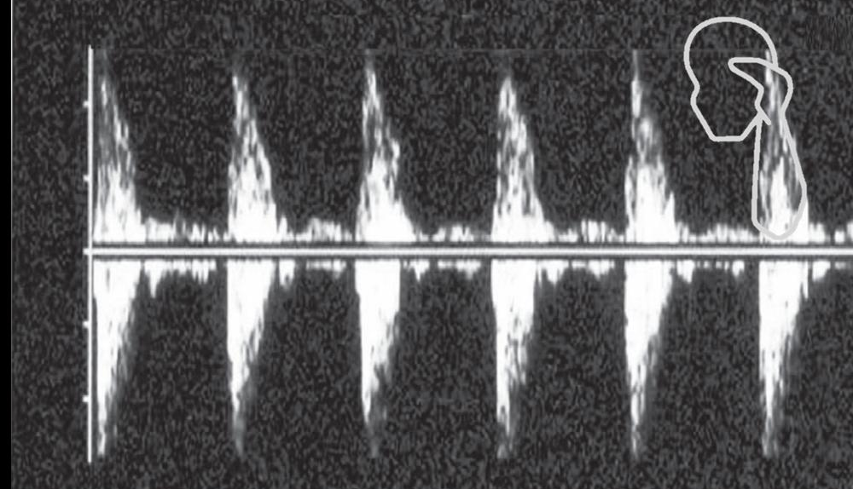
Doppler Artifacts: Crosstalk
Form of mirror image artifact that occurs with spectral Doppler.
Results from the Doppler receiver gain being set too high or from the incident angle being near 90°
Crosstalk appears as an identical Doppler spectrum above and below the baseline. This makes the flow pattern look bidirectional when it is really only unidirectional.

Slide 73
Spectral Analysis
Technique that breaks Doppler signal into basic components and identifies individual velocities
Two methods used to perform spectral analysis:
1) Fast Fourier Transform (FFT)
2) Autocorrelation
Early methods of Doppler analysis such as zero crossing detectors or Chirp-Z transform are now obsolete

Slide 74
Spectral Analysis Cont'd
Fast Fourier Transform:
1) Digital technique used to process both pulsed and continuous wave Doppler
2) Distinguishes laminar from turbulent flow
Autocorrelation:
1) Digital technique used to analyze color flow Doppler

Slide 75
FFT
Advantages
Very accurate
Displays all velocities that make up a complex reflected signal
Distinguishes laminar flow from turbulent flow.

Slide 76
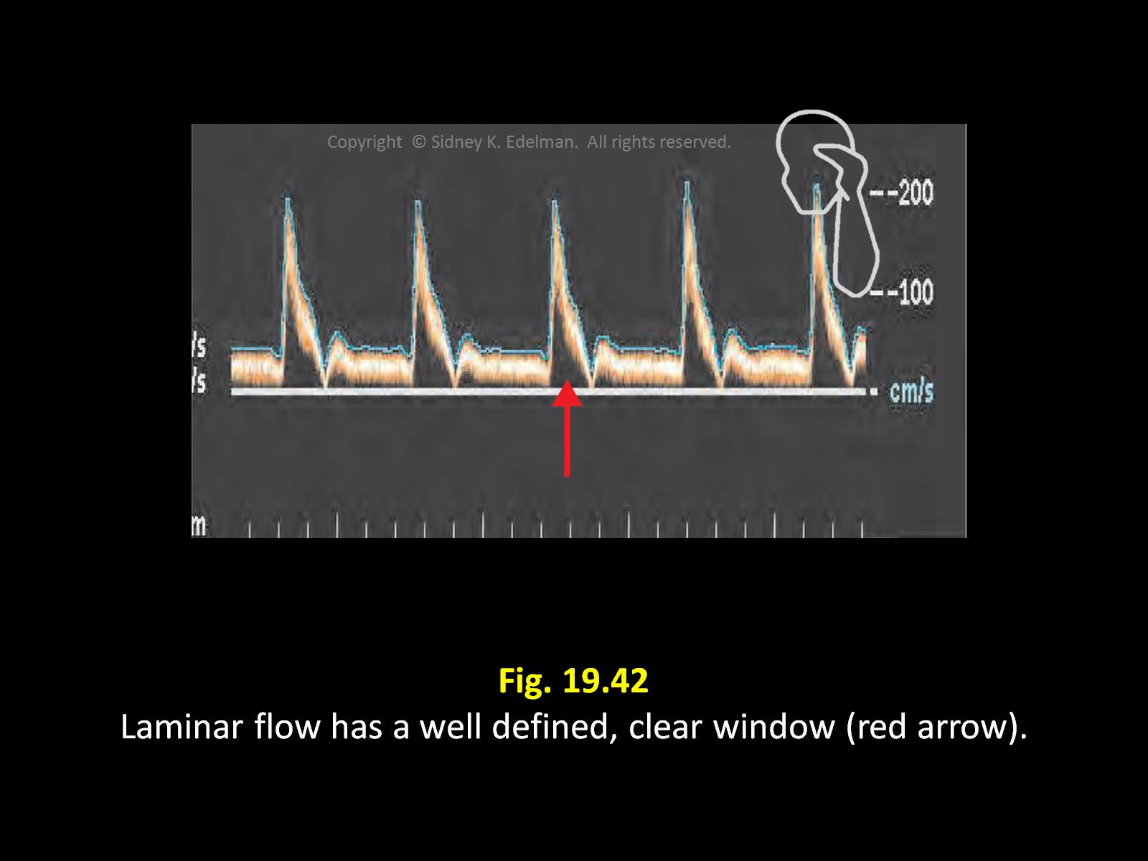

Slide 77
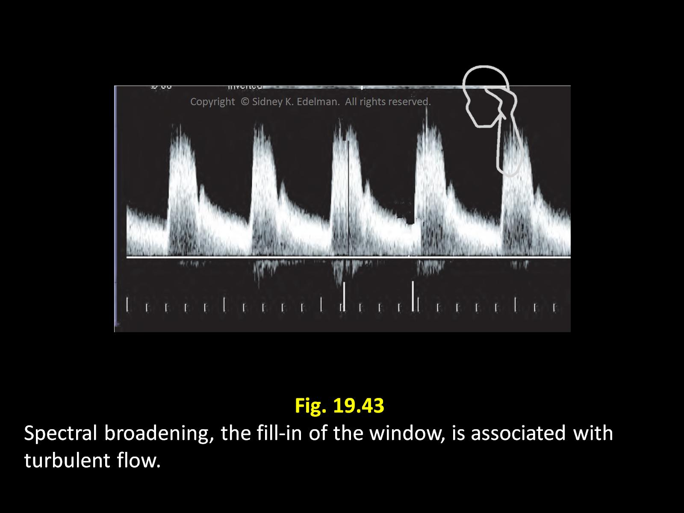

Slide 78
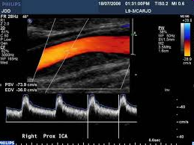

See the difference?
Normal
Spectral broadening (from stenosis)

Slide 79
The area below the waveform on a Doppler signal is called the “envelope”
Normal signals should display a clean envelope.
Normal
Spectral Broadening

Slide 80

Why is spectral broadening associated with pathology?
We know that with laminar flow, most blood cells within the sample volume will travel at similar velocities.
This means the spectral trace will be a narrow, well-defined line.
The region between the baseline and the spectrum (the spectral window) is clear.
With chaotic turbulent flow, the blood is going in many different directions.
The spectral window will be filled in with turbulent flow.
With Spectral Broadening, there is a wider range of velocities and Doppler shifts within the sample volume.

Slide 81
Autocorrelation
Digital techniques to analyze COLOR-FLOW DOPPLER
Color has very large amount of data
Autocorrelation
Less accurate than FFT
Faster to perform than FFT

Slide 82


Color Doppler Processing (Autocorrelation)
Autocorrelation processing looks at color Doppler data from multiple sample volumes.
All frequency shifts from all sample volumes are analyzed for direction, strength and mean values.
All data from all sample volumes are then “averaged” together into a display of mean frequency shifts.

Slide 83


Slide 84
Doppler Derived Diagnostic Indices
Resistivity Index (RI) – Measure of vascular resistance
RI = V max - V min
V max
Pulsatility Index (PI) – Similar to RI
PI = V max – V min
V Mean

Slide 85

Resistive Index
This is a quantitative, Doppler-derived measurement of vascular resistance of a segment in the arterial system.
It is useful in diagnosing arterial stenosis.
It is a ratio and therefore has no units.
RI = Max Velocity – Min Velocity
Max Velocity

Slide 86

Pulsatility Index
It is quite similar to the RI index
Designed to quantify the pulsatility or oscillations of the waveform. The index is particularly valuable when there is diastolic flow reversal, i.e. bidirectional flow.
It is a bit more difficult to calculate because it requires the mean or average velocity for the entire cardiac cycle.
Modern day instruments provide mean velocity measurements automatically.
PI = Max Velocity – Min Velocity
Mean Velocity

Slide 87
Advantages of RI and PI
They are both mathematical measurements rather than subjective descriptions
Both depend only on the waveform shape, not the actual measurements.
Since the formula compares one velocity to another, the only information required is the shape of the Doppler spectrum, thus the calculation is unaffected by the Doppler angle.

Slide 88


